Slide 1
Living Away At University
www.reading.ac.uk

Slide 2

WHAT WE WILL COVER
What does life look like as a student?
Some common concerns and worries

Slide 3

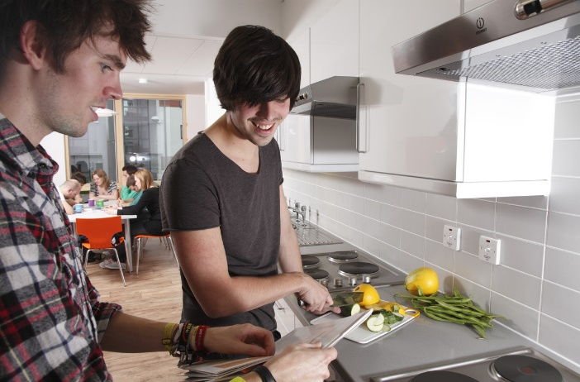
What does ‘student life’ look like?
What skills might you need as a university student?
Notes:
Gather students’ thoughts on what life might look like at university?

Slide 4
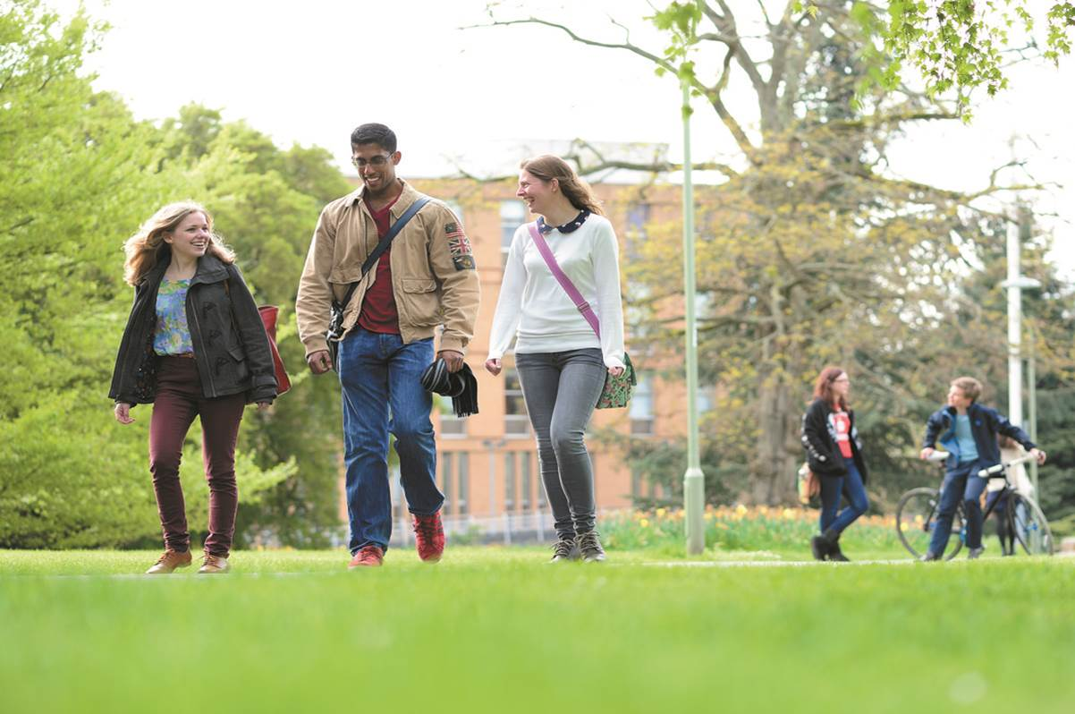
“Being a student means…”:
Lectures, seminars and tutorials
Late nights at the library
Clubs and societies
Part-time job
Work experience
Living in halls
Meeting new people
Learning to cook
Doing your own washing

Slide 5
Should I move away – what is there to gain?
Independence
Life Experience
Responsibility
Notes:
It is a big decision, and many students going to university have never lived away from home before.
There’s a lot to gain. Group students’ ideas under these three main headings.

Slide 6

I don’t want to move away…
“I’ll miss my friends and family”
“Some of my friends aren’t going to uni”
“I’d be leaving my boyfriend/girlfriend behind”
“I can’t cook”
Notes:
Sometimes we hear from students that they’re worried to leave their home town for uni. This might limit their university choices to universities that are within a one hour drive from their house, or easily commutable on a train.
Going to a local university can be great, but it will be a different experience.
There are lots of factors that come into play when making the decision to move away, here are some common concerns that we hear about. Can you think of what you might say to a student who is worried about these things?

Slide 7
“I’ll miss my friends and family”
Students rarely find themselves lonely.
Welcome week is a great time to meet new people and get stuck into university life. There are lots of university clubs and societies to get involved with, and you’ll be getting to know the new town/city that you’re in, as well as getting to know the new people that you’ve moved in with. Then there’s your new course friends, and you’ll be spending time in lectures, seminars and studying for assignments.
Usually we find the opposite, that students are expecting to feel homesick, but in reality, are so busy with their new lives, that they have to remember to call home..!
There’s lots of ways to stay in touch with friends and family back home and depending on how far away you chose to move you can also visit at weekends or in the vacations.

Slide 8
“My friends are doing other things”
Remember, whatever option they choose, whether that’s starting a new job, course or apprenticeship, their lives are about to change a lot too, and you’ll have a lot to share with each other about the new experiences you’re having.
You’re not leaving them ‘behind’. Your Whatsapp will still be busy with chat.
If they decide to stay living at home, you can still visit them at the weekends when you see your parents, or they can some and see you at university and explore a new town/city!
They might be looking at different universities/moving away from home themselves. So long as you don’t mind sleeping on their floor, it might be a great opportunity to go and see places around the country that you haven’t visited before.

Slide 9
“I’d be leaving my boyfriend/girlfriend behind”
We always try to emphasise that you’ve got to make the decision that’s going to be the best for you, not somebody else.
You can always visit them at home at the weekends, and they can always come and stay with you at uni. There is even shared family accommodation if you wanted to pair up together and go to the same university.
Take them with you to look around universities so they are involved with your decision.
If it’s meant to be it will last.

Slide 10
“I can’t cook”
There are different options when it comes to accommodation.
Catered halls offer the opportunity to have some, or all meals provided for you. You’ll still have access to a shared kitchen so you can cook snacks if you want to.
Everyone needs to learn some day. University is a great place to learn, as you always have people around to ask for ideas and help if needed. Family or friends may be able to share recipes with you before you go, and they might like to hear how they go.

Slide 11
Good Luck!
We have lots of resources and events for students to help with university decisions and applications.
Check out our webpages for opportunities to visit the university and recordings and resources to help you stay informed about your choices.
www.reading.ac.uk/outreach

