Slide 1
Introduction to Higher Education
www.reading.ac.uk

Slide 2
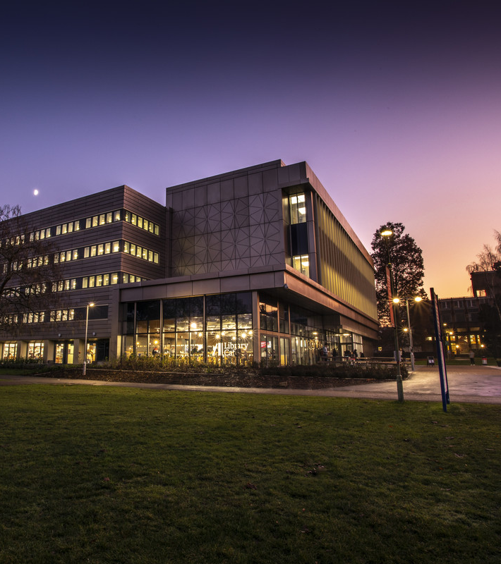
WHAT WE WILL COVER
What are your options?
Why university?

Slide 3
What could your next steps be?
After College/6th form

Slide 4


  Further Education
    A Levels
    BTECs
  Apprenticeships
  Employment with training
  Employment without training
  Higher Education:
    Foundation degree
    Undergraduate degree
  Employment without training
  Employment with training
  Apprenticeship
Year 11
Year 13
Point for reflection:
Why did you choose the options you did in Year 11?
Notes:
Because student have progressed further with their education through choosing Further Education (6th form/college), they now have more options available to them.
They now have more skills and experience to allow them to seek new opportunities.
Apprenticeship programmes or training on the job are options if they have a particular career choice in mind. They’ll start at the bottom and work their way up in a company, whilst taking professional qualifications in that sector.
Some people consider Foundation degrees if they want to gain further knowledge and skills, which will help prepare them for an undergraduate degree.
Undergraduate degrees are generally 3 years in length, and prepare students with a range of skills in a subject area that they are interested in. A university degree will prepare students will academic knowledge, but also transferable skills which link to employability.

Slide 5

Progression
The further you progress, the more options you will have.
Each stage is important and will help you with your future career.

Slide 6
Why go to university?
Study Something You Love
Career Prospects
Understand the World Better
Meet New People
Earn More Money
Try New Things
Gain New Skills

Slide 7

“I don’t know what I want to study…”
80% of employers don’t ask for a particular degree subject
The job market is competitive
Notes:
You don’t need to know exactly what you want to do in the future before going to university.
It’s having a degree that makes you more employable, not having a degree in a particular subject.
80% of employers who ask for a degree don’t specify what subject degree they want candidates to have. This is because they want to employ people that they know will be motivated and hard working in their company, and people who have worked hard for a degree generally show these attributes.
Achieving a university degree means that you will have acquired transferable skills, which give you an edge in the competitive job market, over someone who hasn’t been to university. This will make you more employable and more likely to be considered for the job.

Slide 8

Employability
Confidence
Communication skills
Time management
Problem solving and flexibility
Budgeting and money management
Independence

Slide 9

Research
Notes:
Your first step to university is to start some research:
The course you want to study – What are your interests at the moment? Do you have a particular job in mind?
Where you might like to study – What grades are you working towards? What ‘entry requirements’ might you be looking at?
What kind of university might you like to go to? – A campus university, or a city university? One that is far away from home, or more local?

Slide 10
Good Luck!
We have lots of resources and events for students to help with university decisions and applications.
Check out our webpages for opportunities to visit the university and recordings and resources to help you stay informed about your choices.
www.reading.ac.uk/outreach

